Slide 1
International institute of professional studies davv indore
Digital computer organization
PPT
MCA (6-YEARS) (III-SEM)
SECTION “A”
SUBMITTED TO: SUBMITTED BY:
Dr. Shaligram Prajapat Kamlesh Gaikwad

Slide 2
UNIT : 1 INTRODUCTION
INRODUCTION TO COMPUTER ORGANIZATION
Computer architecture refers to those attributes of a system visible to a program or, put another way, those attributes that have a direct impact on the logical execution of a program. Computer organization refers to the operational units and their interconnections that realize the architectural specifications. Examples of architectural attributes include the instruction set, the number of bits used to represent various data types (e.g., numbers, characters), I/O mechanisms, and techniques for addressing memory. Organizational attributes include those hardware details transparent to the programmer, such as control signals; interfaces between the computer and peripherals; and the memory technology used.
For example, it is an architectural design issue whether a computer will have a multiply instruction. It is an organizational issue whether that instruction will be implemented by a special multiply unit or by a mechanism that makes repeated use of the add unit of the system .The organizational decision may be based on the anticipated frequency of use of the multiply instruction, the relative speed of the two approaches, and the cost and physical size of a special multiply unit.

Slide 3
Structure and function
At each level, the system consists of a set of components and their interrelationships .The behavior at each level depends only on a simplified, abstracted characterization of the system at the next lower level. At each level, the designer is concerned with structure and function:
Structure: The way in which the components are interrelated
Function: The operation of each individual component as part of the structure
In terms of description, we have two choices: starting at the bottom and building up to a complete description, or beginning with a top view and decomposing the system into its subparts. Evidence from a number of fields suggests that the top down approach is the clearest and most effective [WEIN75].

Slide 4
Function
All computer functions are:
Data processing
Data storage
Data movement
Control

Slide 5
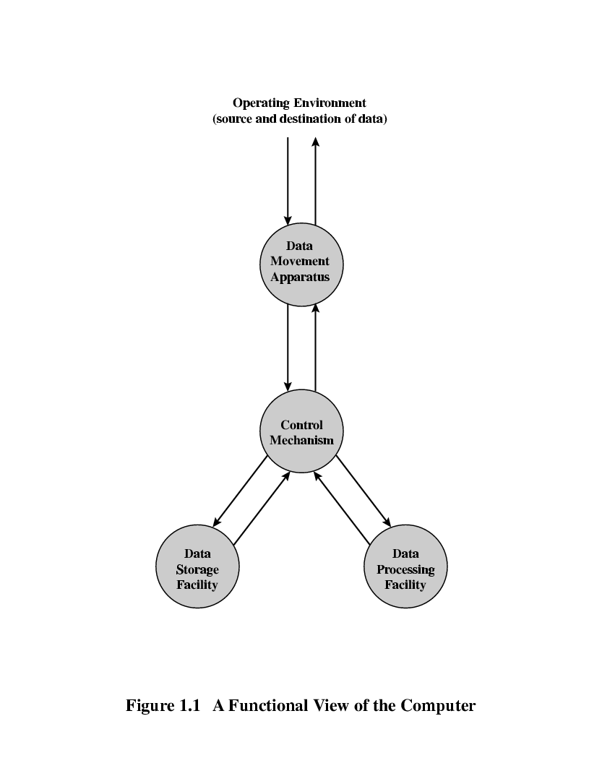
Functional View

Slide 6
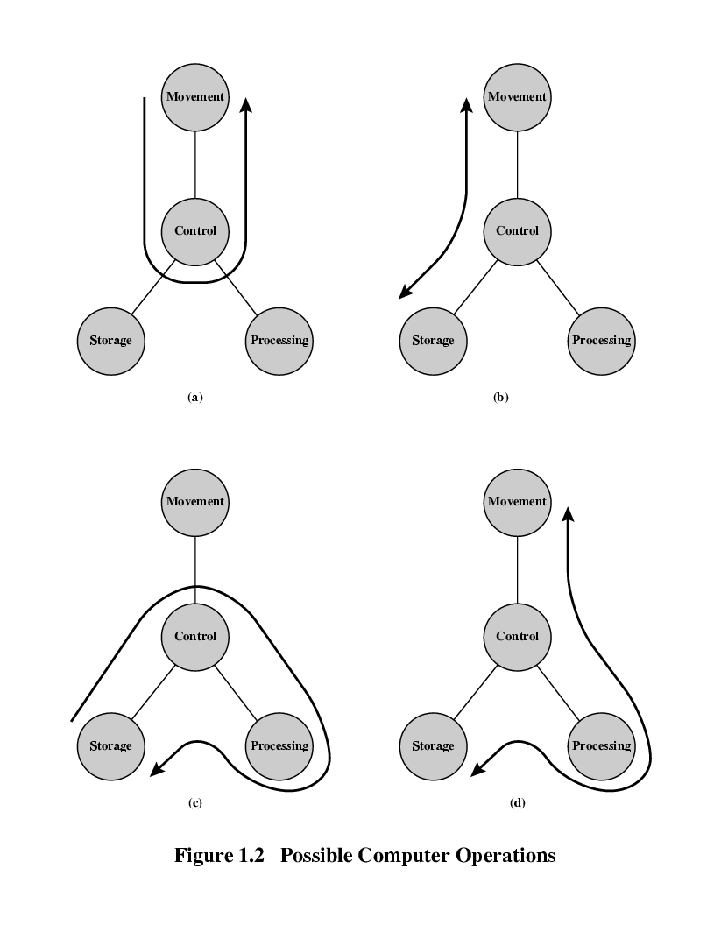
Operations: 1. Data movement

Slide 7
2. Storage

Slide 8
3. Processing from/to storage

Slide 9
4.Processing from storage to I/O

Slide 10
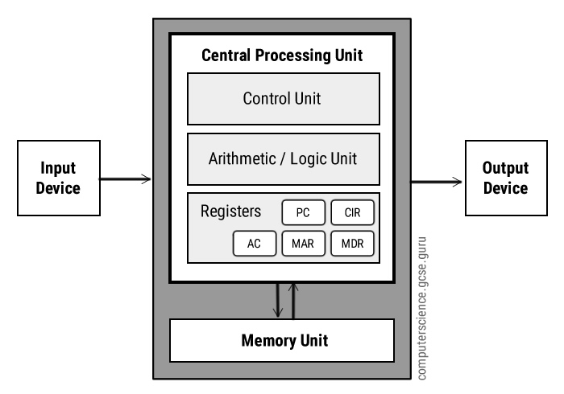
VON NEUMANN ARCHITECTURE

Slide 11
Von Neumann architecture was first published by John von Neumann in 1945.
His computer architecture design consists of a Control Unit, Arithmetic and Logic Unit (ALU), Memory Unit, Registers and Inputs/Outputs.
Von Neumann architecture is based on the stored-program computer concept, where instruction data and program data are stored in the same memory.

Slide 12
Central processing unit (cpu)
The Central Processing Unit (CPU) is the electronic circuit responsible for executing the instruction of the computer program .
It is sometimes referred to as the microprocessor or processor.
The CPU contains the ALU, CU and a variety of registers.

Slide 13
REGISTERs
Registers are the high speed storage areas in the CPU. All data must be stored in a register before it can be processed .
MAR :- Memory Address Register holds the memory location of data that needs to be accessed.
MDR :-Memory Data Register holds data that is being transferred to or from memory.
AC :-Accumulator where intermediate arithmetic and logical results are stored.
PC :-Program Counter contains the address of the next instruction to be executed.
CIR :-Current Instruction Register contains the current instruction during processing.

Slide 14
ARITHMETIC AND LOGICAL UNIT (ALU)
The ALU allows arithmetic (add, subtract etc) and logical (AND, OR, NOT etc)operations to be carried out.
Control unit (cu)
The control unit controls the operation of the computer’s ALU, memory and input/output devices, telling them how to respond to the program instructions it has just read and interpreted from the memory unit.
The control unit also provides the timing and control signals required by other computer components.

Slide 15
buses
A bus is a communication pathway connecting two or more devices. A key characteristic of a bus is that it is a shared transmission medium. Multiple devices connect to the bus, and a signal transmitted by any one device is available for reception by all other devices attached to the bus
A standard CPU system bus is comprised of :-
1) Address Bus
2) Data Bus
3) System Bus

Slide 16
Address bus
Identify the source or destination of data
e.g. CPU needs to read an instruction (data) from a given location in memory
Bus width determines maximum memory capacity of system
e.g. 8080 has 16 bit address bus giving 64k address space

Slide 17
Data bus
Carries data between the processor , the memory unit and the input/output devices.
Remember that there is no difference between “data” and “instruction” at this level.
Width is a key determinant of performance
eg :- 8, 16, 32, 64 bit

Slide 18
Control bus
The control lines are used to control the access to and the use of the data and address lines.
The data and address lines are shared by all components.
Control and timing information
Memory read/write signal
Interrupt request
Clock signals

Slide 19
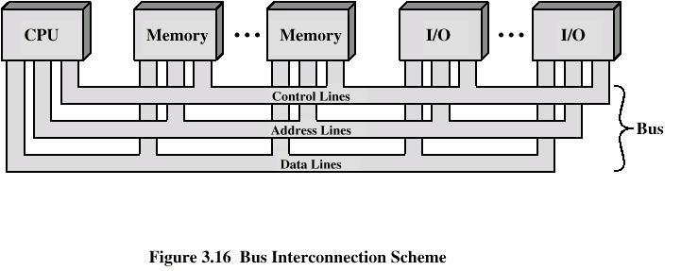
Bus interconnection scheme

Slide 20
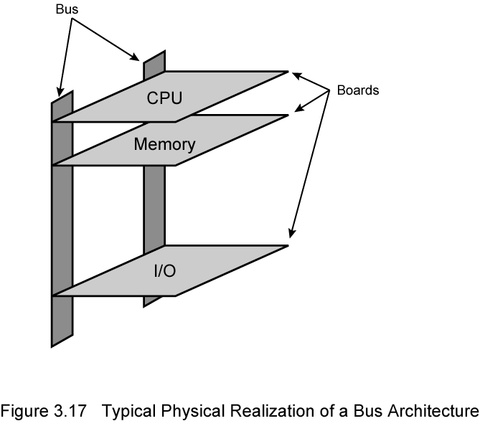
Physical Realization of Bus architecture

Slide 21
Single bus problems
Lots of devices on one bus leads to:
Propagation delays
Long data paths mean that co-ordination of bus use can adversely affect performance
If aggregate data transfer approaches bus capacity
Most systems use multiple buses to overcome these problems

Slide 22
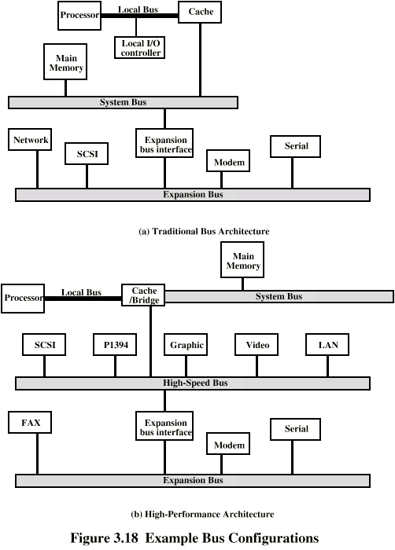
Traditional (ISA) (with cache)

Slide 23
High Performance Bus

Slide 24
Types of buses
Dedicated Bus
Permanently assigned either to one function or to a physical subset of computer components.
Separate data & address lines.
Multiplexed Bus
Shared lines
Address valid or data valid control line
Advantage - fewer lines
Disadvantages
More complex control
Ultimate performance

Slide 25
method of Arbitration
More than one module controlling the bus.
e.g. CPU and DMA controller
Only one module may control bus at one time
Arbitration may be centralised or distributed

Slide 26
Centralized or distributed arbitration
Centralised Arbitration
Single hardware device controlling bus access
Bus Controller
Arbiter
May be part of CPU or separate
Distributed Arbitration
Each module may claim the bus
Control logic on all modules

Slide 27
timing
Timing refers to the way in which events are coordinated on the bus.
Synchronous Timing
Events determined by clock signals
Control Bus includes clock line
A single 1-0 is a bus cycle
All devices can read clock line
Usually sync on leading edge
Usually a single cycle for an event

Slide 28
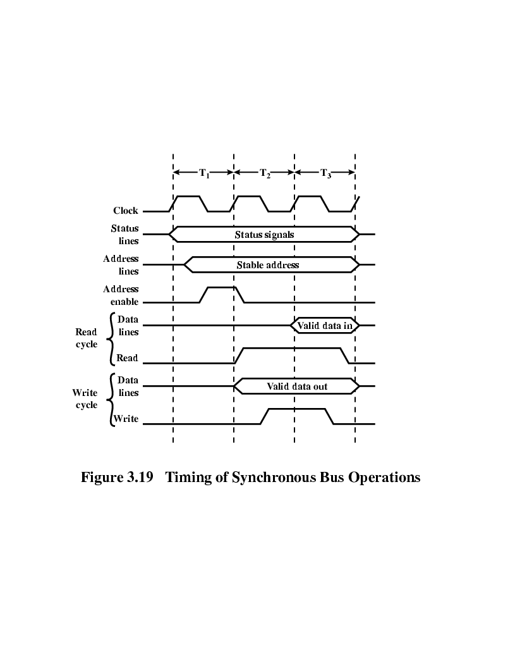
Synchronous Timing Diagram

Slide 29
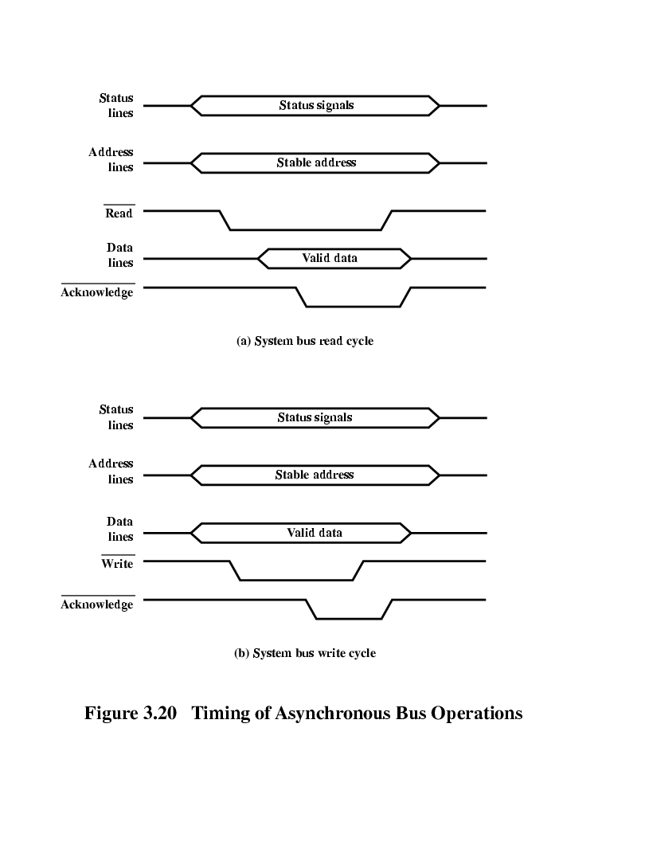
Asynchronous Timing – Read Diagram

Slide 30
Asynchronous Timing – Write Diagram

Slide 31
Computer components
Data and instructions are stored in a single read–write memory.
• The contents of this memory are addressable by location, without regard to the type of data contained there.
• Execution occurs in a sequential fashion (unless explicitly modified) from one instruction to the next.
The Control Unit and the Arithmetic and Logic Unit constitute the Central Processing Unit.

Slide 32
Computer components : Top level view
The CPU exchanges data with memory. For this purpose, it typically makes use of two internal (to the CPU) registers: a memory address register (MAR), which specifies the address in memory for the next read or write, and a memory buffer register (MBR), which contains the data to be written into memory or receives the data read from memory. Similarly, an I/O address register (I/OAR) specifies a particular I/O device. An I/O buffer (I/OBR) register is used for the exchange of data between an I/O module and the CPU.

Slide 33
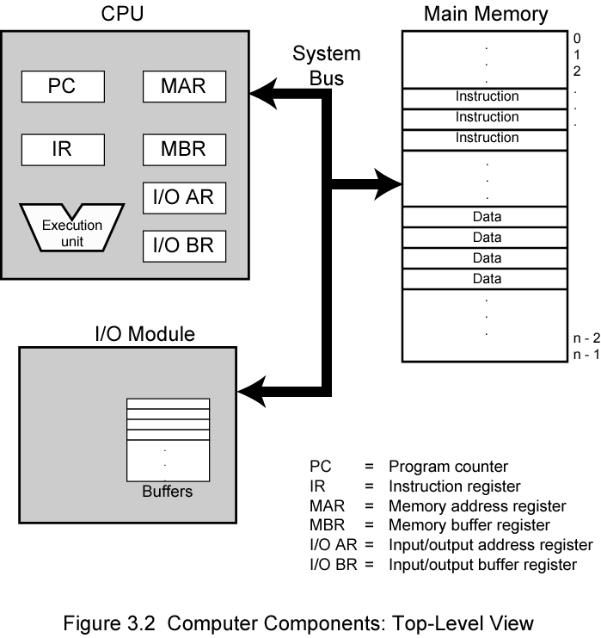
Top level view

Slide 34
Interconnection structures
The collection of paths connecting the various modules is called the interconnection structure.
The design of this structure will depend on the exchanges that must be made among modules.
Memory Connection
Receives and sends data
Receives addresses (of locations)
Receives control signals
Read
Write
Timing

Slide 35
input/output module
Similar to memory from computer’s viewpoint
Output
Receive data from computer
Send data to peripheral
Input
Receive data from peripheral
Send data to computer

Slide 36
Receive control signals from computer
Send control signals to peripherals
e.g. spin disk
Receive addresses from computer
e.g. port number to identify peripheral
Send interrupt signals (control)

Slide 37
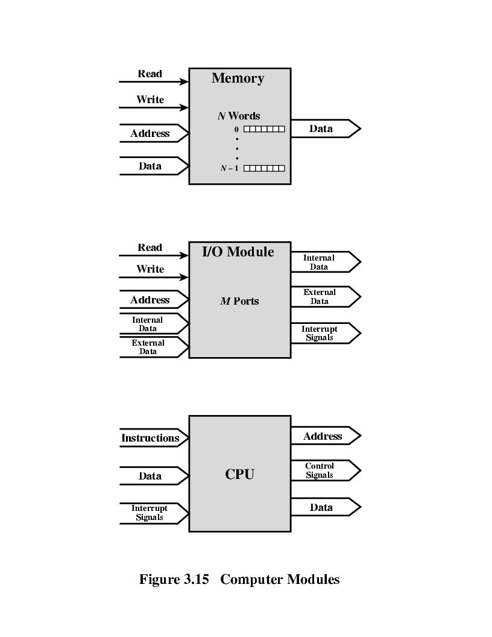

Computer module

Slide 38
Cpu interconnection
Reads instruction and data
Writes out data (after processing)
Sends control signals to other units
Receives (& acts on) interrupts

Slide 39
The interconnection structure must support the following types of transfers:
Memory to processor: The processor reads an instruction or a unit of data from memory.
Processor to memory:- The processor writes a unit of data to memory.
I/O to processor:- The processor reads data from an I/O device via an I/O module.
Processor to I/O:- The processor sends data to the I/O device.
I/O to or from memory:- For these two cases, an I/O module is allowed to exchange data directly with memory, without going through the processor, using direct memory access (DMA).

Slide 40
UNIT - 3

Slide 41
MEMORY ORGANZATION
Computer memory is organized into a hierarchy. At the highest level closest to the processor are the processor registers. Next comes one or more levels of cache
Next comes main memory, which is usually made out of dynamic random-access memory (DRAM).All of these are considered internal to the computer system.

Slide 42
MEMORY HIERARCHY
In computer architecture, the memory hierarchy separates computer storage into a hierarchy based on response time.
The memory hierarchy was developed based on a program behaviour known as locality of references.

Slide 43
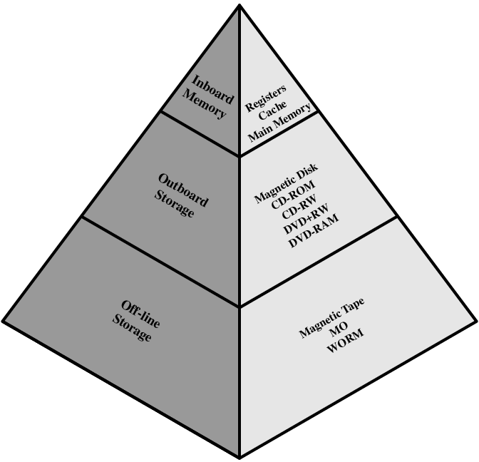

Slide 44
Memory Hierarchy
Registers
Cache Memory
Internal or main memory
External memory

Slide 45
INTERNAL MEMORY
Internal memory is often equated with main memory. But there are other forms of internal memory. The processor requires its own local memory in the form registers.

Slide 46
Semiconductor Main Memory
Read/write
Volatile
Temporary Storage
The two basic forms of semiconductor random access memory are dynamic RAM (DRAM) and static RAM (SRAM).
The basic element of a semiconductor memory is the memory cell.

Slide 47
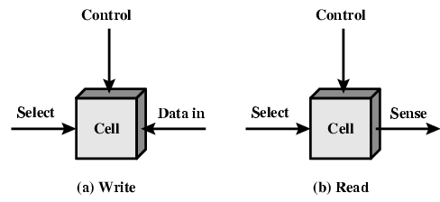
Memory Cell Operation

Slide 48
DYNAMIC RAM
The term dynamic refers to this tendency of the stored charge to leak away, even with power continuously applied.
A dynamic RAM (DRAM) is made with cells that store data as charge on capacitors.
The presence or absence of charge in a capacitor is interpreted as a binary 1 or 0. Because capacitors have a natural tendency to discharge.
Dynamic RAM require periodic charge refreshing to maintain data storage.

Slide 49
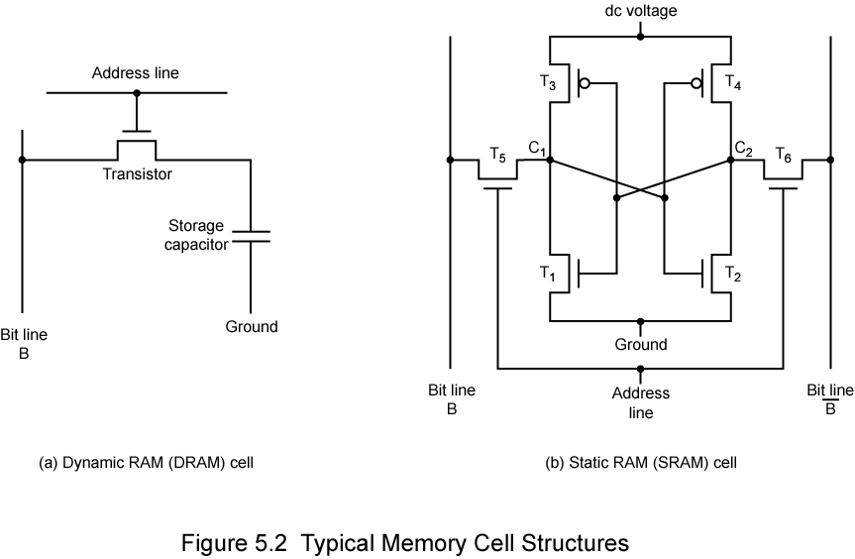
DYNAMIC RAM STRUCTURE

Slide 50
DRAM OPERATION
Address Line
-- The address line is activated when the bit value from this cell is to be read or written.
Write Operation
--- A voltage signal is applied to the bit line ; a high voltage represents 1,and a low voltage represents 0.
--- .A signal is then applied to the address line, allowing a charge to be transferred to the capacitor.
Read Operation
--- when the address line is selected, the transistor turns on and the charge stored on the capacitor is fed out onto a bit line.
--- Compares the capacitor voltage to a reference value and determines if the cell contains a logic 1 or a logic 0.
--- The readout from the cell discharges the capacitor, which must be restored to complete the operation.

Slide 51
STATIC RAM
A static RAM (SRAM) is a digital device that uses the same logic elements used in the processor.
In a SRAM, binary values are stored using traditional flip-flop logic-gate configurations.
A static RAM will hold its data as long as power is supplied to it.
No refreshing needed when powered
More complex construction
Larger per bit
More expensive
Does not need refresh circuits
Faster

Slide 52
STATIC RAM STRUCTURE

Slide 53
STATIC RAM OPERATION
Four transistors (T1,T2,T3,T4) are cross connected in an arrangement that produces a stable logic state.
STATE 1 –
Point C1 is high and point C2 is low.
T1 and T4 are off and T2 and T3 are on.
STATE 0 –
point C1 is low and point C2 is high
T1 and T4 are on and T2 and T3 are off.
Both states are stable as long as the direct current (dc) voltage is applied. Unlike the DRAM, n o refresh is needed to retain data.
Address line transistors T₅ T₆ is switch
Write – apply value to B & compliment to B
Read – value is on line B.

Slide 54
SRAM VERSUS DRAM
Both static and dynamic RAMs are volatile.
A dynamic memory cell is simpler and smaller than a static memory cell.
A DRAM is more dense and less expensive than a corresponding SRAM.
SRAMs are generally somewhat faster than DRAMs.
Because of these relative characteristics, SRAM is used for cache memory (both on and off chip),and DRAM is used for main memory.

Slide 55
read-only memory
ROM stands for Read Only Memory.
The memory from which we can only read but cannot write on it. This type of memory is non-volatile.
The information is stored permanently in such memories during manufacture.
A ROM stores such instructions that are required to start a computer.
ROM chips are not only used in the computer but also in other electronic items like washing machine and microwave oven.

Slide 56
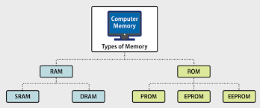
TYPES OF ROM MEMORY
There are five basic ROM types:
PROM
EPROM
EEPROM

Slide 57
programmable read-only memory
PROM or programmable ROM (programmable read-only memory) is a computer memory chip that can be programmed once after it is created.
Once the PROM is programmed, the information written is permanent and cannot be erased or deleted.
PROM was first developed by Wen Tsing Chow in 1956. Today, PROM in computers has been replaced by EEPROM

Slide 58
erasable programmable read-only memory
EPROM or erasable programmable read-only memory, is a type of programmable read-only memory (PROM) chip that retains its data when its power supply is switched off.
Computer memory that can retrieve stored data after a power supply has been turned off and back on is called non-volatile.
Once programmed, an EPROM can be erased by exposing it to strong ultraviolet light source.

Slide 59
electrically erasable programmable read-only memory
EEPROM stands for electrically erasable programmable read-only memory and is a type of non-volatile memory.
EEPROMs are organized as arrays of floating-gate transistors.
EEPROMs can be programmed and erased in-circuit, by applying special programming signals.
Flash memory is a type of EEPROM designed for high speed and high density.

Slide 60
External Memory
External storage comprises devices that store information outside a computer. Such devices may be permanently attached to the computer, may be removable or may use removable media.
Types of external storage
Magnetic storage
Optical storage
Compact disc

Slide 61
CACHE MEMORY
Cache memory is a small-sized type of volatile computer memory that provides high-speed data access to a processor and stores frequently used computer programs, applications and data.
It is the fastest memory in a computer, and is typically integrated onto the motherboard and directly embedded in the processor or main random access memory (RAM).
Cache memory provides faster data storage and access by storing instances of programs and data routinely accessed by the processor. Thus, when a processor requests data that already has an instance in the cache memory.
Cache memory is an extremely fast memory type that acts as a buffer between RAM and the CPU.
It holds frequently requested data and instructions so that they are immediately available to the CPU when needed.
Cache memory is used to reduce the average time to access data from the Main memory. The cache is a smaller and faster memory which stores copies of the data from frequently used main memory locations.

Slide 62
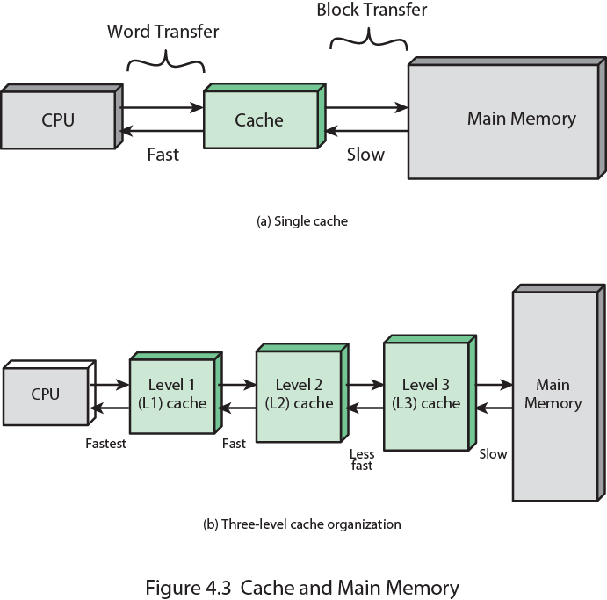
Cache Memory

Slide 63
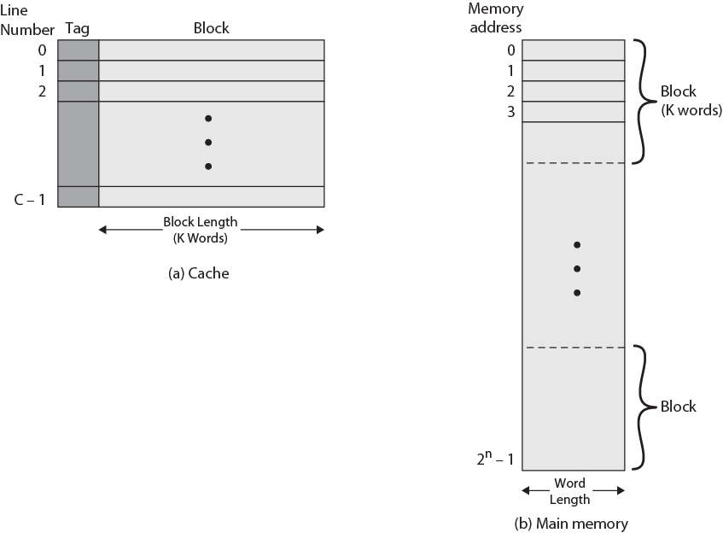
Cache/Main Memory Structure

Slide 64
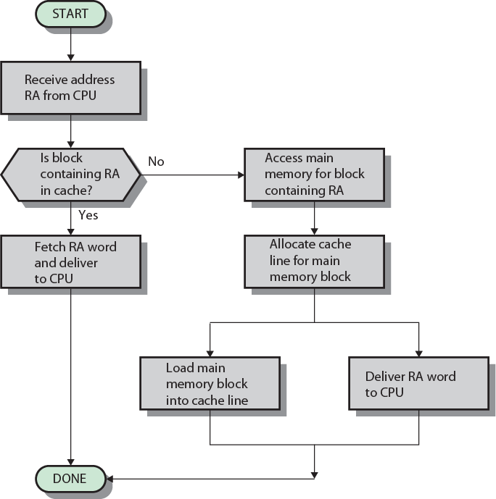
Cache Read Operation

Slide 65
Cache Address
Almost all non-embedded processors, and many embedded processors, support virtual memory. In essence, virtual memory is a facility that allows programs to address memory from a logical point of view, without regard to the amount of main memory physically available. When virtual memory is used, the address fields of machine instructions contain virtual addresses. For reads to and writes from main memory, a hardware memory management unit (MMU) translates each virtual address into a physical address in main memory.
When virtual addresses are used, the system designer may choose to place the cache between the processor and the MMU or between the MMU and main memory. A logical cache, also known as a virtual cache, stores data using virtual addresses. The processor accesses the cache directly, without going through the MMU. A physical cache stores data using main memory physical addresses.

Slide 66
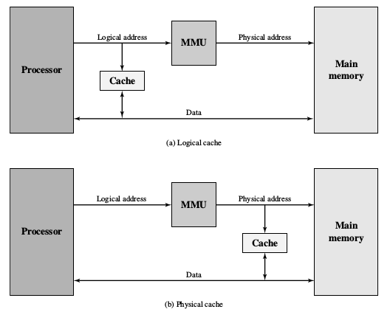
Cache Address

Slide 67
MAPPING TECHNIQUE
Because there are fewer cache lines than main memory blocks, an algorithm is needed for mapping main memory blocks into cache lines. Further, a means is needed for determining which main memory block currently occupies a cache line. The choice of the mapping function dictates how the cache is organized. Three techniques can be used: direct, associative, and set associative.
DIRECT MAPPING: The simplest technique, known as direct mapping, maps each block of main memory into only one possible cache line. The mapping is expressed as
i = j modulo m
where i cache line number, j main memory block number, m number of lines in the cache
shows the mapping for the first blocks of main memory. Each block of main memory maps into one unique line of the cache. The next blocks of main memory map into the cache in the same fashion; that is, block Bm of main memory maps into line L0 of cache, block Bm1 maps into line L1, and so on.

Slide 68
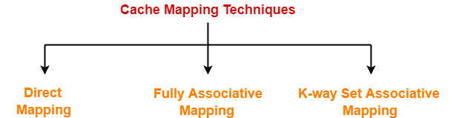
Mapping techniques
Direct Mapping
Fully Associative Mapping
K-way Set Associative Mapping

Slide 69
Direct Mapping-
A particular block of main memory can map to only one particular line of the cache.
The line number of cache to which a particular block can map is given by-
Cache line number= ( Main Memory Block Address ) Modulo (Number of lines in Cache)

Slide 70
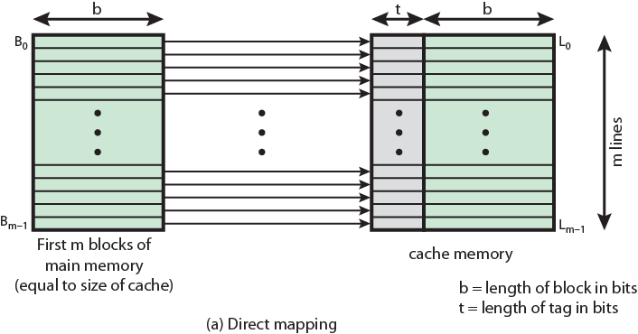
Direct Mapping from Cache to Main Memory

Slide 71
Direct Mapping Cache Line Table
Cache line | Main Memory blocks held
0 | 0, m, 2m, 3m…2s-m
1 | 1,m+1, 2m+1…2s-m+1
…
m-1 | m-1, 2m-1,3m-1…2s-1

Slide 72
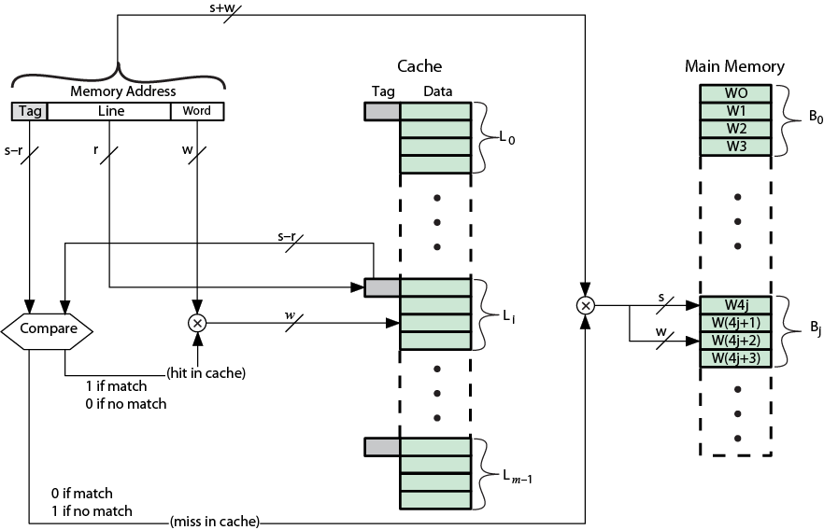
Direct Mapping Cache Organization

Slide 73
Associative Mapping
A main memory block can load into any line of cache
Memory address is interpreted as tag and word
Tag uniquely identifies block of memory
Every line’s tag is examined for a match
Cache searching gets expensive

Slide 74
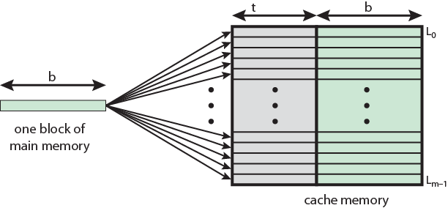
Associative Mapping from Cache to Main Memory

Slide 75
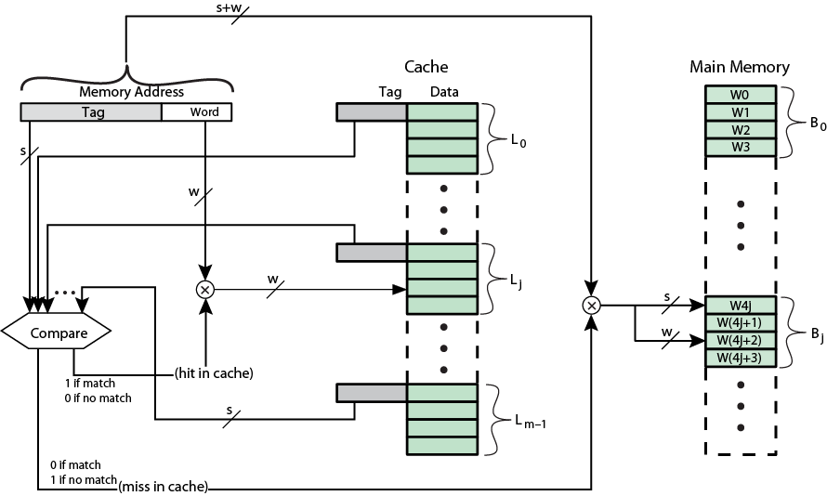
Fully Associative Cache Organization

Slide 76
Set Associative Mapping
Set-associative mapping is a compromise that exhibits the strengths of both the direct and associative approaches while reducing their disadvantages. In this case, the cache consists of a number sets, each of which consists of a number of lines. The relationships are
m = v * k
i = j modulo n
Where
i cache set number
j main memory block number
m number of lines in the cache
V number of sets
k number of lines in each set

Slide 77
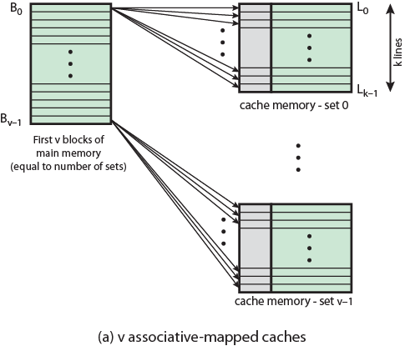
Mapping From Main Memory to Cache: v Associative

Slide 78
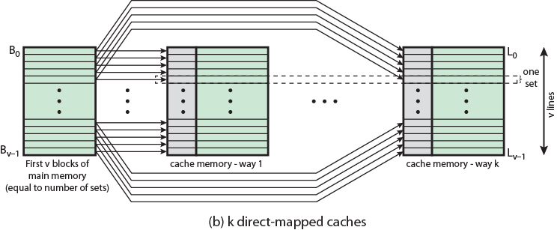
Mapping From Main Memory to Cache: k-way Associative

Slide 79
VIRTUAL MEMORY
Virtual Memory is a storage allocation scheme in which secondary memory can be addressed as though it were part of main memory. The addresses a program may use to reference memory are distinguished from the addresses the memory system uses to identify physical storage sites, and program generated addresses are translated automatically to the corresponding machine addresses.
The size of virtual storage is limited by the addressing scheme of the computer system and amount of secondary memory is available not by the actual number of the main storage locations.
It is a technique that is implemented using both hardware and software. It maps memory addresses used by a program, called virtual addresses, into physical addresses in computer memory.

Slide 80
VIRTUAL MEMORY
All memory references within a process are logical addresses that are dynamically translated into physical addresses at run time. This means that a process can be swapped in and out of main memory such that it occupies different places in main memory at different times during the course of execution.
A process may be broken into number of pieces and these pieces need not be continuously located in the main memory during execution. The combination of dynamic run-time address translation and use of page or segment table permits this.

Slide 81
Secondary storage devices
A secondary storage device refers to any non-volatile storage device that is internal or external to the computer. It can be any storage device beyond the primary storage that enables permanent data storage.
A secondary storage device is also known as an auxiliary storage device or external storage.
Secondary storage devices are primarily referred to a storage devices that serve as an addition to the computer's primary storage, RAM and cache memory.

Slide 82
Magnetic Disk
Magnetic disks remain the most important component of external memory.
A disk is a circular platter constructed of nonmagnetic material, called the substrate, coated with a magnetizable material.
The substrate has been an aluminium or aluminium alloy material. More recently, glass substrates have been introduced.
The glass substrate has a number of benefits :-
significant reduction in overall surface defects.
Ability to support lower fly heights.
Better stiffness to reduce disk dynamics
Greater ability to withstand shock and damage.

Slide 83
Read And Write Mechanisms
Data are recorded on and later retrieved from the disk via a conducting coil named the head.
There are two heads, a read head and a write head
During a read or write operation the head is stationary while the platter rotates beneath it
The write mechanism exploits the fact that electricity flowing through a coil produces a magnetic field.
Electric pulses are sent to the write head and the resulting magnetic patterns are recorded on the surface below, with different patterns for positive and negative currents.

Slide 84
MAGNETIC TAPE
Tape systems use the same reading and recording techniques as disk systems. The medium is flexible polyester (similar to that used in some clothing) tape coated with magnetizable material. The coating may consist of particles of pure metal in special binders or vapor-plated metal films. The tape and the tape drive are analogous to a home tape recorder system. Tape widths vary from 0.38 cm (0.15 inch) to 1.27 cm 0.5 inch). Tapes used to be packaged as open reels that have to be threaded through a second spindle for use. Today, virtually all tapes are housed in cartridges.
Data on the tape are structured as a number of parallel tracks running lengthwise. Earlier tape systems typically used nine tracks. This made it possible to store data one byte at a time, with an additional parity bit as the ninth track. This was followed by tape systems using 18 or 36 tracks, corresponding to a digital word or double word. The recording of data in this form is referred to as parallel recording.

Slide 85
OPTICAL STORAGE
Optical storage is the storage of data on an optically readable medium. Data is recorded by making marks in a pattern that can be read back with the aid of light, usually a beam of laser light precisely focused on a spinning optical disc.
An optical disc drive is a device in a computer that can read CD-ROMs or other optical discs, such as DVDs and Blue-ray discs. Optical storage differs from other data storage techniques that make use of other technologies such as magnetism, such as floppy disks and hard disks, or semiconductors, such as flash memory and RAM.

Slide 86
Compact Disk
CD-ROM Both the audio CD and the CD-ROM (compact disk read-only memory) share a similar technology . The main difference is that CD-ROM players are more rugged and have error correction devices to ensure that data are properly transferred from disk to computer.
The disk is formed from a resin, such as polycarbonate. Digitally recorded information (either music or computer data) is imprinted as a series of microscopic pits on the surface of the polycarbonate
This is done first of all with a finely focused high-intensity laser to create a master disk. The master is used in turn to make a die to stamp out copies onto polycarbonate. The pitted surface is then coated with a highly reflective surface, usually aluminium or gold . This shiny surface is protected against dust and scratches by a top coat of clear acrylic.

Slide 87
ADVANTAGES -
The optical disk together with the information stored on it can be mass replicated inexpensively—unlike a magnetic disk. The database on a magnetic disk has to be reproduced by copying one disk at a time using two disk drives.
he optical disk is removable, allowing the disk itself to be used for archival storage. Most magnetic disks are non removable. The information on non-removable magnetic disks must first be copied to another storage medium before the disk drive/disk can be used to store new information.
DISADVANTAGES –
It is read-only and cannot be updated.
It has an access time much longer than that of a magnetic disk drive , as much as half a second.

Slide 88
Digital Versatile Disk (DVD)
DVD (digital versatile disc) is a digital optical disc storage format invented and developed in 1995. The medium can store any kind of digital data and is widely used for software and other computer files as well as video programs watched using DVD players. DVDs offer higher storage capacity than compact discs while having the same dimensions.
The DVD has replaced the videotape used in video cassette recorders (VCRs) and, more important for this discussion, replace the CD-ROM in personal computers and servers. The DVD takes video into the digital age . It delivers movies with impressive picture quality , and it can be randomly accessed like audio CDs , which DVD machines can also play.

Slide 89
UNIT - 4

Slide 90
CPU ORGANISATION
CPU Acts as the brain of computer.
Performs all the calculations & controls all the components. Carries out the instructions of a computer program, performs the basic arithmetical, logical, and input and output operations of the system.
CPU Has Two Main Components Control Unit (CU), Arithmetic & Logic Unit (ALU).
Control Unit Selects program instructions & coordinates their execution. Regulates timing of processor. Sends control signal to and receives control signal from peripheral devices. Acts as central nervous system for all other components. It obtains instruction from memory, interprets the instruction & issues signals to the required units to carry out the execution.
ALU Actual execution of instruction takes place in ALU. It consists of a complicated set of logic circuit, registers and accumulator to carry out all operations. Depends on the commands given by the Control Unit.

Slide 91
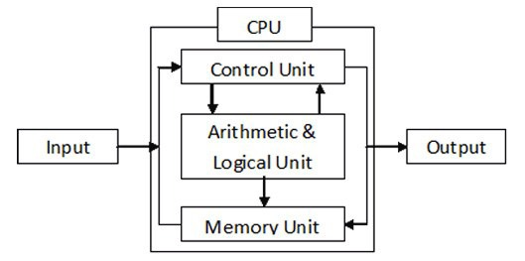
CPU ORGANISATION
The major components of the processor are an arithmetic and logic unit(ALU) and a control unit(CU). The ALU does the actual computation or processing of data. The control unit controls the movement of data and instructions into and out of the processor and controls the operation of the ALU.

Slide 92
REGISTER ORGANISATION
When we are using multiple general purpose registers, instead of single accumulator register, in the CPU Organization then this type of organization is known as General register based CPU Organization.
In this type of organization, computer uses two or three address fields in their instruction format. Each address field may specify a general register or a memory word.
If many CPU registers are available for heavily used variables and intermediate results, we can avoid memory references much of the time, thus vastly increasing program execution speed, and reducing program size.

Slide 93
ADVANTAGES –
Efficiency of CPU increases as there are large number of registers are used in this organization.
Less memory space is used to store the program since the instructions are written in compact way.
DISADVANTAGES –
Care should be taken to avoid unnecessary usage of registers. Thus, compilers need to be more intelligent in this aspect.
Since large number of registers are used, thus extra cost is required in this organization.

Slide 94
The registers in the processor perform two roles:
User-visible registers : Enable the machine- or assembly language programmer to minimize main memory references by optimizing use of registers.
Control and status registers : Used by the control unit to control the operation of the processor and by privileged, operating system programs to control the execution of programs.

Slide 95
User-visible registers :
A user-visible register is one that may be referenced by means of the machine language that the processor executes. We can characterize these in the following categories:
General purpose
Data
Address
Condition codes
General-purpose registers can be assigned to a variety of functions by the programmer. Sometimes their use within the instruction set is orthogonal to the operation.

Slide 96
Data registers may be used only to hold data and cannot be employed in the calculation of an operand address . Address registers may themselves be somewhat general purpose, or they may be de-voted to a particular addressing mode.
Address registers:
Address registers may themselves be somewhat general purpose, or they may be de-voted to a particular addressing mode.
Condition codes: A final category of registers, which is at least partially visible to the user, holds condition codes. Condition codes are bits set by the processor hardware as the result of operations.

Slide 97
Control register:
There are a variety of processor registers that are employed to control the operation of the processor. Most of these, on most machines, are not visible to the user. Some of them may be visible to machine instructions executed in a control or operating system mode. different machines will have different register organizations and use different terminology. The four essential registers are:
Program counter (PC): Contains the address of an instruction to be fetched
Instruction register (IR): Contains the instruction most recently fetched
Memory address register (MAR): Contains the address of a location in memory
Memory buffer register (MBR): Contains a word of data to be written to memory or the word most recently read

Slide 98
STACK ORGANISATION
A useful feature that is included in the CPU of most computers is a stack or last-in, first-out (LIFO) list. A stack is a storage device that stores information in such a manner that the item stored last is the first item retrieved. The operation of a stack can be compared to a stack of trays. The last tray placed on top of the stack is the first to be taken off. The stack in digital computers is essentially a memory unit with an address register that can count only (after an initial value is loaded into it). The register that holds the address for the stack is called a stack pointer (SP) because its value always points at the top item in the stack. Contrary to a stack of trays where the tray itself may be taken out or inserted, the physical registers of a stack are always available for reading or writing. It is the content of the word that is inserted or deleted.
The two operations of a stack are the insertion and deletion of items. The operation of insertion is called push (or push-down) because it can be through of as the result of pushing a new item on top. The operation of deletion is called pop (or pop-up) because it can be thought of as the result of removing one item so hat the stack pops up.

Slide 99
INSTRUCTION FORMATS
A computer will usually have a variety of instruction code formats. It is the function of the control unit within the CPU to interpret each instruction code and provide the necessary control functions needed to process the instruction.
The format of an instruction is usually depicted in a rectangular box symbolizing the bits of the instruction as they appear in memory words or in a control register. The bits of the instruction are divided into groups called fields. The most common fields found in instruction formats are:
1. An operation code field that specifies the operation to be performed.
2. An address field that designates a memory address or a processor register.
3. A mode field that specifies the way the operand or the effective address is determined.

Slide 100
THREE-ADDRESS INSTRUCTIONS
Computers with three-address instruction formats can use each address field to specify either a processor register or a memory operand. The program in assembly language that evaluates X =(A + B) ∗ (C + D) is shown below, together with comments that explain the register transfer operation of each instruction.
ADD R1, A, B R1 ← M [A] + M [B]
ADD R2, C, D R2 ← M [C] + M [D]
MUL X, R1, R2 M [X] ← R1 ∗ R2
It is assumed that the computer has two processor registers, R1 and R2. The symbol M [A] denotes the operand at memory address symbolized by A.

Slide 101
TWO-ADDRESS INSTRUCTIONS
Two address instructions are the most common in commercial computers. Here again each address field can specify either a processor register or a memory word. The program to evaluate X = (A + B) ∗ (C + D) is as follows:
MOV R1, A R1 ← M [A]
ADD R1, B R1 ← R1 + M [B]
MOV R2, C R2 ← M [C]
ADD R2, D R2 ← R2 + M [D]
MUL R1, R2 R1 ← R1 ∗ R2
MOV X, R1 M [X] ← R1
The MOV instruction moves or transfers the operands to and from memory and processor registers. The first symbol listed in an instruction is assumed to be both a source and the destination where the result of the operation is transferred.

Slide 102
ONE-ADDRESS INSTRUCTIONS
One-address instructions use an implied accumulator (AC) register for all data manipulation. For multiplication and division there is a need for a second register. However, here we will neglect the second and assume that the AC contains the result of tall operations. The program to evaluate X = (A + B) ∗ (C + D) is
LOAD A AC ← M [A]
ADD B AC ← A [C] + M [B]
STORE T M [T] ← AC
LOAD C AC ← M [C]
ADD D AC ← AC + M [D]
MUL T AC ← AC ∗ M [T]
STORE X M [X] ← AC
All operation are done between the AC register and a memory operand. T is the address of a temporary memory location required for storing the intermediate result.

Slide 103
ZERO-ADDRESS INSTRUCTIONS
A stack-organized computer does not use an address field for the instructions ADD and MUL.
The PUSH and POP instructions, however, need an address field to specify the operand that
communicates with the stack. The following program shows how X = (A + B) ∗ (C + D) will be
written for a stack organized computer. (TOS stands for top of stack)
PUSH A TOS ← A
PUSH B TOS ← B
ADD TOS ← (A + B)
PUSH C TOS ← C
PUSH D TOS ← D
ADD TOS ← (C + D)
MUL TOS ← (C + D) ∗ (A + B)
POP X M [X] ← TOS
To evaluate arithmetic expressions in a stack computer, it is necessary to convert the expression into reverse Polish notation. The name “zero-address” is given to this type of computer because of the absence of an address field in the computational instructions

Slide 104
ADDRESSING NODES
The operation field of an instruction specifies the operation to be performed. This operation must
be executed on some data stored in computer registers or memory words. The way the operands
are chosen during program execution in dependent on the addressing mode of the instruction.
To understand the various addressing modes to be presented in this section, it is imperative that we understand the basic operation cycle of the computer. The control unit of a computer is designed to go through an instruction cycle that is divided into three major phases:
1. Fetch the instruction from memory
2. Decode the instruction.
3. Execute the instruction.

Slide 105
Immediate Mode :
In this mode the operand is specified in the instruction itself. In
other words, an immediate-mode instruction has an operand field rather than an address field. The operand field contains the actual operand to be used in conjunction with the operation specified in the instruction. Immediate-mode instructions are useful for initializing registers to a constant value.
It was mentioned previously that the address field of an instruction may specify either a memory word or a processor register. When the address field specifies a processor register, the instruction is said to be in the register mode.
Register Mode :
In this mode the operands are in registers that reside within the CPU. The particular register is selected from a register field in the instruction. A k-bit field can specify any one of 2k registers.

Slide 106
Register Indirect Mode :
In this mode the instruction specifies a register in the CPU whose contents give the address of the operand in memory. In other words, the selected register contains the address of the operand rather than the operand itself. Before using a register indirect mode instruction, the programmer must ensure that the memory address of the operand is placed in the processor register with a previous instruction. A reference to the register is then equivalent to specifying a memory address. The advantage of a register indirect mode instruction is that the address field of the instruction sues fewer bits to select a register than would have been required to specify a memory address directly.

Slide 107
Direct Address Mode:
In this mode the effective address is equal to the address part of the instruction. The operand resides in memory and its address is given directly by the address field of the instruction. In a branch-type instruction the address field specifies the actual branch address.
Indirect Address Mode:
In this mode the address field of the instruction gives the address where the effective address is stored in memory. Control fetches the instruction from memory and uses its address part to access memory again to read the effective address.

Slide 108
Indexed Addressing Mode:
In this mode the content of an index register is added to the address part of the instruction to obtain the effective address. The index register is a special CPU register that contains an index value. The address field of the instruction defines the beginning address of a data array in memory. Each operand in the array is stored in memory relative to the beginning address. The distance between the beginning address and the address of the operand is the index value stores in the index register. Any operand in the array can be accessed with the same instruction provided that the index register contains the correct index value..

Slide 109
unit : 5 control unit
Instruction word format
A three address format has a operand#1, operand#2, and a result. No intermediate registers are required to do any computation . In a one address machine there is a general purpose register called an “Accumulator” that is an implied operand along with the single memory address contained in the instruction.

Slide 110
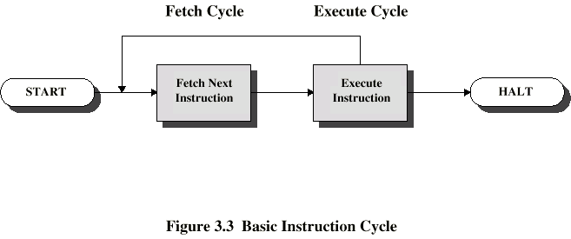
instruction cycle
Two steps:-
Fetch: Read the next instruction from memory into the processor.
Execute: Interpret the opcode and perform the indicated operation.

Slide 111
Fetch cycle
Program Counter (PC) holds address of next instruction to fetch
Processor fetches instruction from memory location pointed to by PC
Increment PC
Unless told otherwise
Instruction loaded into Instruction Register (IR)
Processor interprets instruction and performs required actions

Slide 112
Execution cycle
Processor-memory
data transfer between CPU and main memory
Processor I/O
Data transfer between CPU and I/O module
Data processing
Some arithmetic or logical operation on data
Control
Alteration of sequence of operations
e.g. jump
Combination of above

Slide 113
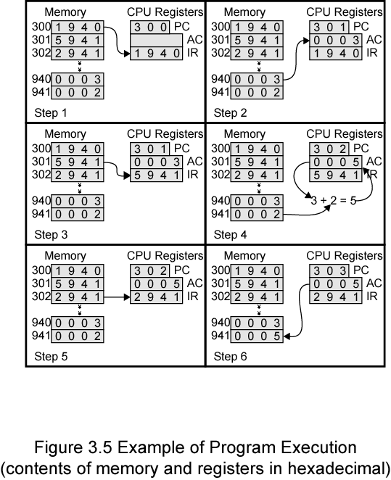
Example of Program Execution

Slide 114
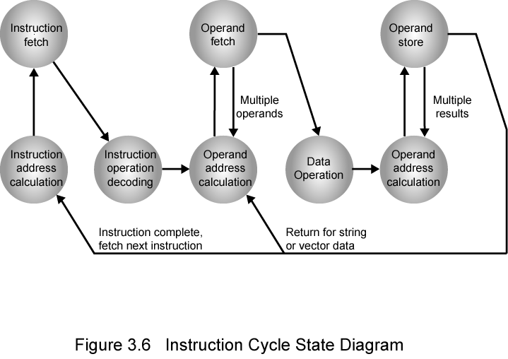
Instruction Cycle State diagram

Slide 115
Sequence of operation of control registers
Register in the control unit of the CPU that is used to keep track of the address of the current or next instruction , and then the current instruction is executed. Also known as a “sequence control register” and the “instruction pointer” .

Slide 116
Control of arithmetic operations
An arithmetic logic unit (ALU) is a combinational digital electronic circuit that performs arithmetic and bitwise operations on integer binary numbers. This is in contrast to a floating point unit (FPU) ,which operates on floating point numbers. An ALU is a fundamental building block of many types of computing circuits, including the central processing unit (CPU) of computers, FPUs ,and graphics processing units (GPUs). A single CPU,FPU or GPU may contain multiple ALUs.

Slide 117
microprogramming
The term microprogram was first coined by M.V.Wilkes in the early 1950s [WILK51]. Wilkes proposed an approach to control unit design that was organized and systematic and avoided the complexities of a hardwired implementation .The idea intrigued many researchers but appeared unworkable because it would require a fast, relatively inexpensive control memory.
The state of the microprogramming art was reviewed by Datamation in its February 1964 issue. No microprogrammed system was in wide use at that time, and one of the papers [HILL64] summarized the then-popular view that the future of microprogramming “is somewhat cloudy. None of the major manufacturers has evidenced interest in the technique, although presumably all have examined it.”

Slide 118
In computer architecture, the memory hierarchy separates computer storage into a hierarchy based on response time. Since response time, complexity, and capacity are related, the levels may also be distinguished by their performance and controlling technologies.[1] Memory hierarchy affects performance in computer architectural design, algorithm predictions, and lower level programming constructs involving locality of reference.

Slide 119
There are four major storage levels:-
Internal – Processor registers and cache.
Main – the system RAM and controller cards.
On-line mass storage – Secondary storage.
Off-line bulk storage – Tertiary and Off-line storage.
This is a general memory hierarchy structuring. Many other structures are useful. For example, a paging algorithm may be considered as a level for virtual memory when designing a computer architecture, and one can include a level of near line storage between online and offline storage

Slide 120
Unit 2: input output organization
Input –output interface
Input-output interface provides a method for transferring information between internal storage and external I/O devices. Peripheral are connected to the central processing unit with a special communication link(I/O bus).
The I/O bus from the processor is attached to all peripheral interfaces.

Slide 121
Module Function
The major functions or requirements for an I/O module fall into the following categories:
■■ Control and timing
■■ Processor communication
■■ Device communication
■■ Data buffering
■■ Error detection

Slide 122
The control of the transfer of data from an external device to the processor required sequence of steps:
1. The processor interrogates the I/O module to check the status of the attached device.
2. The I/O module returns the device status.
3. If the device is operational and ready to transmit, the processor requests the transfer of data, by means of a command to the I/O module.
4. The I/O module obtains a unit of data (e.g., 8 or 16 bits) from the external device.
5. The data are transferred from the I/O module to the processor

Slide 123
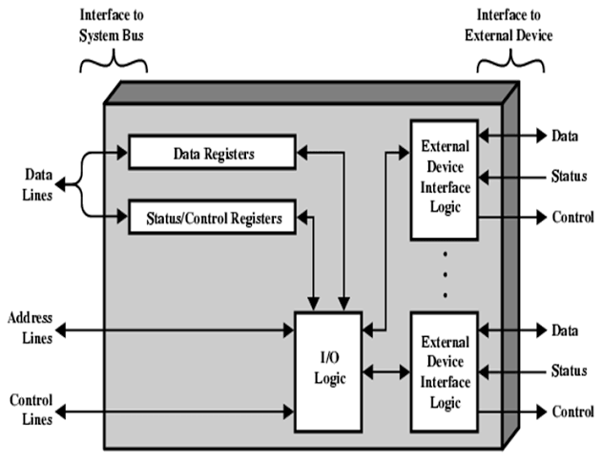
I/O Module Structure

Slide 124
There are four types of I/O commands that an I/O module may receive when it is addressed by a processor :-
Control : Used to activate a peripheral and tell it what to do.
Test : Used to test various status conditions associated with an I/O module and its peripherals.
Read : Causes the I/O module to obtain an item of data from the peripheral and place it in an internal buffer .
Write : Causes the I/O module to take an item of data (byte or word) from the data bus and subsequently transmit that data item to the peripheral.

Slide 125
Interrupt driven I/O
The problem with programmed I/O is that the processor has to wait a long time for the I/O module of concern to be ready for either reception or transmission of data. The processor, while waiting, must repeatedly interrogate the status of the module. As a result, the level of the performance of the entire system is severely degraded.
An alternative is for the processor to issue an I/O command to a module and then go on to do some other useful work. The I/O module will then interrupt the processor to request service when it is ready to exchange data with the processor .The processor then executes the data transfer, as before, and then resumes its former processing.

Slide 126
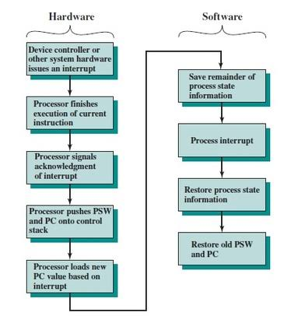
Interrupt processing

Slide 127
Priority interrupt
Priority interrupt are the systems that establishes a Priority over the various sources to determine which condition is to be serviced first when two or more requests arrive simultaneously.
This system may also determine which condition are permitted to interrupt to the computer while another interrupt is being serviced.

Slide 128
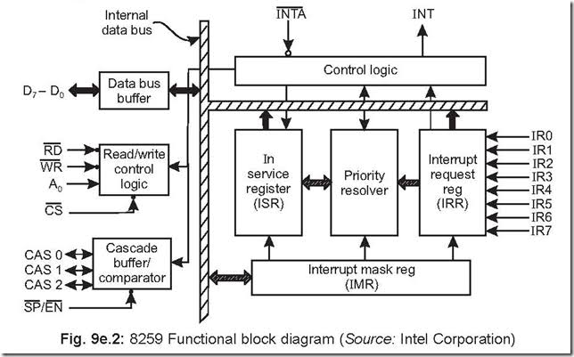
Priority interrupt controller

Slide 129
Direct memory access (dma)
DMA involves an additional module on the system bus. The DMA module is capable of mimicking the processor and, indeed, of taking over control of the system from the processor. It needs to do this to transfer data to and from memory over the system bus.
For this purpose, the DMA module must use the bus only when the processor does not need it, or it must force the processor to suspend operation temporarily. The latter technique is more common and is referred to as cycle stealing, because the DMA module in effect steals a bus cycle.

Slide 130
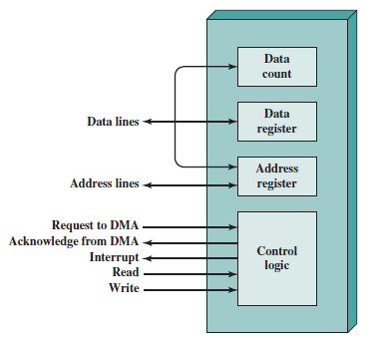
Dma block diagram

Slide 131
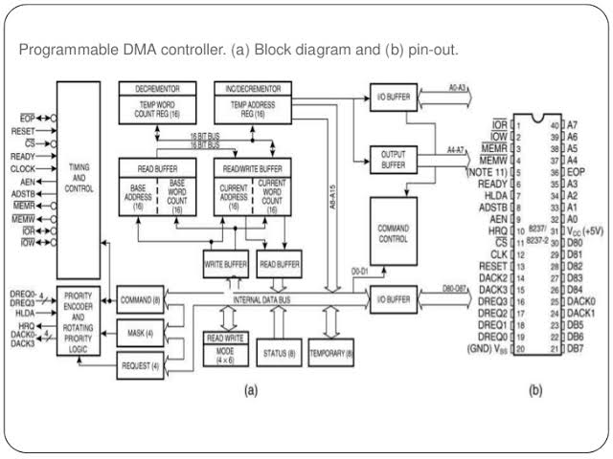
DMA CONTROLLER
This is a device which handles many IO devices which want to perform DMA operation.

Slide 132
i/o processor
This is an special purpose processor which can perform IO operations or IO jobs. It provides logical extension of the IO control methods. It can execute instructions. It has its own instruction set. But the instructions are restricted to be IO data transfer.
IO processor provides communication link between IO devices and computer. They are also known as Peripheral Processing Unit (PPU).

Slide 133
Serial communication
In telecommunication and data transmission ,serial communication is the process of sending data one bit at a time, sequentially, over a communication, where several bits are sent as a whole, on a link with several parallel channels.
Serial communication is used for all long-haul communication and most of computer network where the cost of cable and synchronization difficulties make parallel communication impractical.

Slide 134
Synchronous data transfer
Synchronous transmission is a data transfer method which is characterized by a continuous stream of data in the form of signals which are accompanied by regular timing signals which are generated by some external clocking mechanism meant to ensure that both the sender and receiver are synchronized with each other.

Slide 135
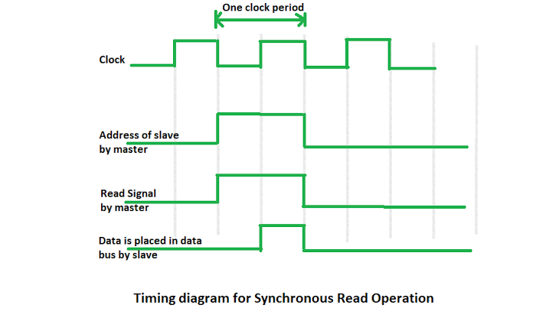
Synchronous data transfer

Slide 136
aSynchronous data transfer
Asynchronous serial data transfer. In most computer asynchronous mode of data transfer is used in which two component have a different clock. ... A start bit is denoted by 0 and stop bit is detected when line return to 1-state at least one time, here 1-state means that there is not data transfer is occurring

Slide 137
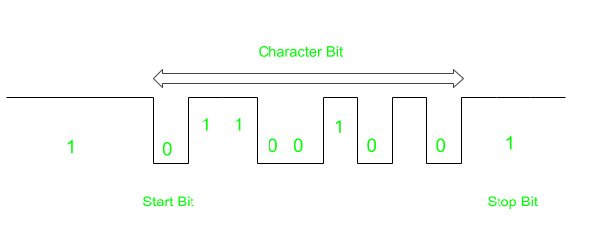
aSynchronous data transfer

Slide 138
Strobe control
In computer or memory technology, a strobe is a signal that is sent that validates data or other signals on adjacent parallel lines. In memory technology, the CAS (column address strobe) and RAS ( row address strobe ) signals are used to tell a dynamic RAM that an address is a column or row address.

Slide 139
Handshaking
The process by which two devices initiate communications. Handshaking begins when one device sends a message to another device indicating that it wants to establish a communications channel. The two devices then send several messages back and forth that enable them to agree on communications protocol.

Slide 140
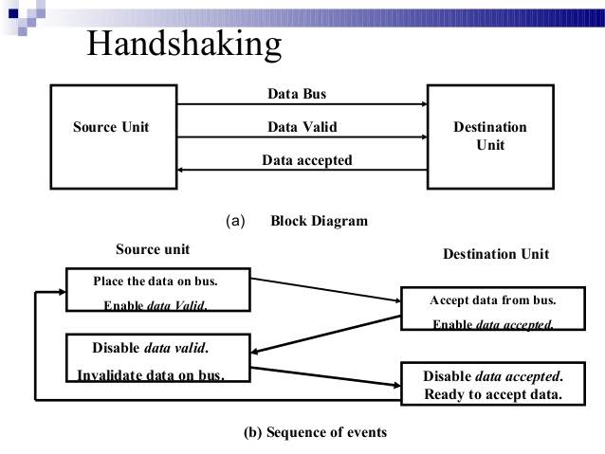

Slide 141
Peripheral component interconnect
Conventional PCI, often shortened to PCI, is a local computer bus for attaching hardware devices in a computer. PCI is an abbreviation for Peripheral Component Interconnect and is part of the PCI Local Bus standard.
The PCI bus supports the functions found on a processor bus but in a standardized format that is independent of any particular processor's native bus.

Slide 142
PCI Bus Lines required
Systems lines
Including clock and reset
Address & Data
32 time max lines for address/data
Interrupt & validate lines
Interface Control
Arbitration
Not shared
Direct connection to PCI bus arbiter
Error lines

Slide 143
PCI Commands
Transaction between initiator (master) and target
Master claims bus
Determine type of transaction
e.g. I/O read/write
Address phase
One or more data phases

Slide 144
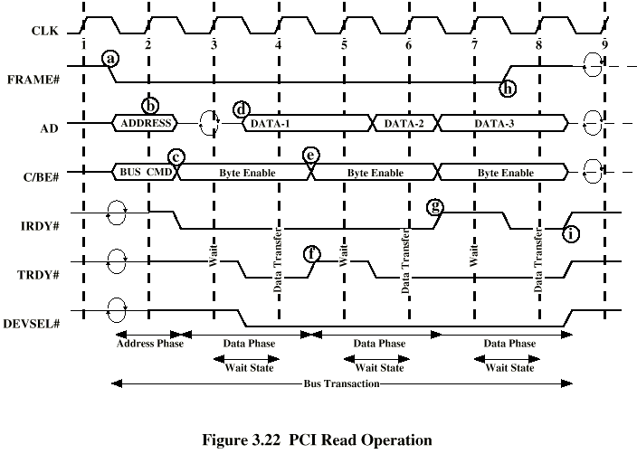
PCI Read Timing Diagram

Slide 145
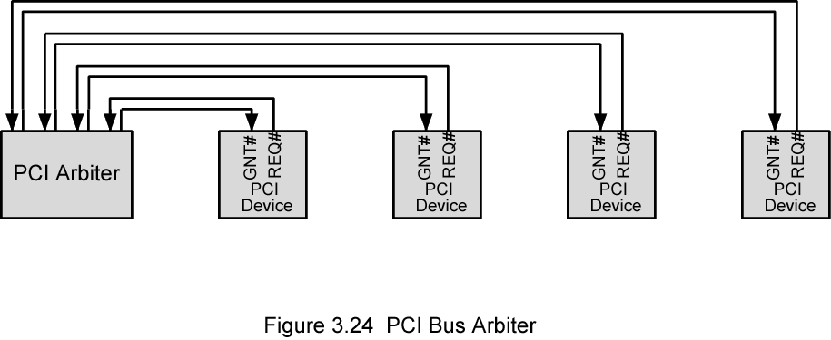
PCI Bus Arbiter

Slide 146
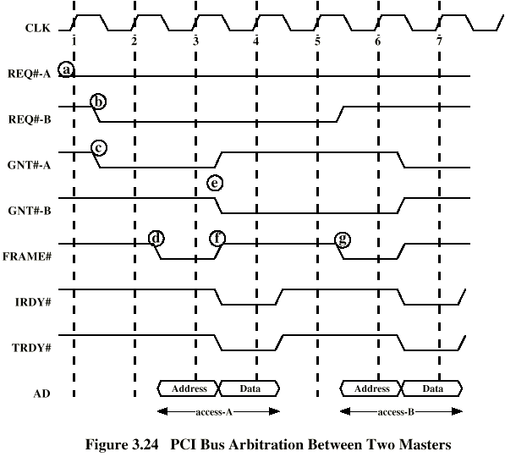
PCI Bus Arbitration

Slide 147
End thank you !

